Slide 1
Deep evolutionary modeling of condition monitoring data in marine
propulsion systems
Sankalp Agrawal

Slide 2
Overview
This study presents a deep evolutionary based approach to optimally model and to predict the physical behaviours in industrial assets from operational data.
The evolutionary modelling process is combined with LSTM which are trained and used to predict the sequences of data over a number of time steps.
The proposed approach is applied to model and predict set of the temperatures related to marine propulsion system, anticipating anomalies and changes in operating conditions.

Slide 3
Test Scenario
Data acquired from a CODOG (combined diesel or gas) marine propulsion system.
The system is designed for using diesel engines for cruising at economical speed or using gas turbines for cruising at high speed.
The reduction gear assembly is the heart of the combustion engine. It allows to lower the input speed with same or more output torque. Usually known as reduction gear box.
The proposed deep evolutionary modelling approach has been tested on 1 year operational data, of a port side marine vessel reduction gear.

Slide 4
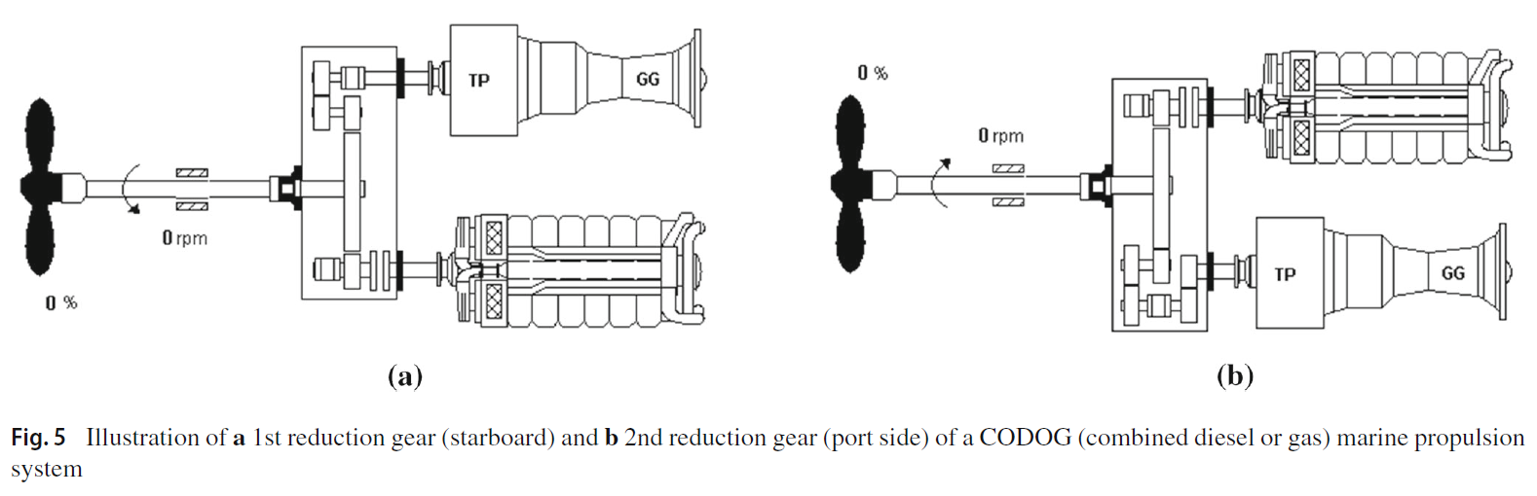
TP: POWER TURBINE
GG: GAS GENERATOR

Slide 5
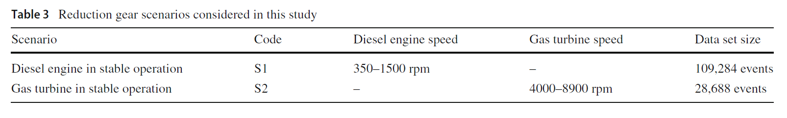
S1: diesel Engine in stable operation and S2: gas turbine in stable operation.
Target variables were identified as characteristic parameter of reduction gear physical behaviour.
They are engine pinion bearing and the gas turbine thrust bearing temperatures and they represent different range of values and variability depending on reduction gear operating condition.

Slide 6
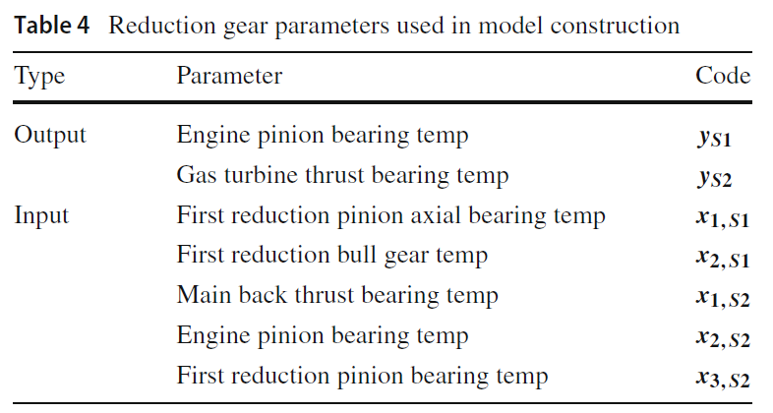
These were the corresponding parameters used in the study

Slide 7
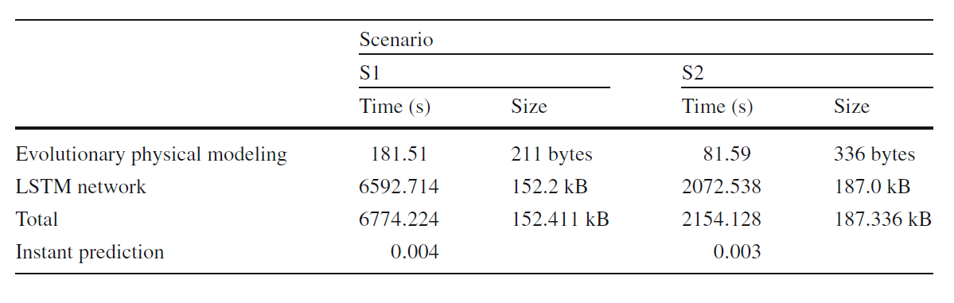
The above table represents the computational time for the conducted experiments on author’s computer.
a random event was investigated to calculate the required computational time for online anomaly prediction.
According to the result obtained, the required computational time for online warning is considerably small.

Slide 8
Result and Discussion
Data splitted into:
Training : 60%
Testing : 30%
Validation : 10%
Training set was used for learning the evolutionary physical models.
Testing sets was used for testing.
Predictions made by evolutionary physical model were used to train the LSTM network, which was tested over validation dataset.
The overall performance is quantified by computing the Mean Absolute Error (MAE), Mean Squared Error (MSE) and Coefficient of determination (R2).
In the case of the LSTM network predictions, the produced sequences of size l are compared to the estimations made by the evolutionary model learned and the validation data during training and testing phases, respectively.

Slide 9
In order to evaluate the performance achieved in the modelling stage, results are compared to those obtained by optimized version of the classification & Regression Tree (CART) algorithm and Multi-Layer Perceptron (MLP) network for sequence prediction.
Test were conducted setting the maximum tree depth to 20 and using the same LSTM network configuration parameters as the basis for the MLP architecture.
A ten fold cross-validation, Shapiro–Wilk and Levene tests are also executed on test and validation datasets, which are the training and test stages in relation to the MLP and LSTM networks.

Slide 10
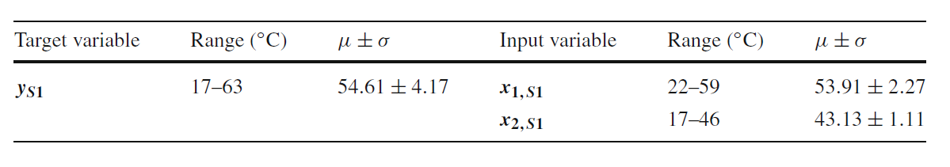
Scenario S1:
Range of values of reduction gear used in this study regarding scenario S!.
y_{s1} is the engine pinion bearing temperature.
x_{1,S1} is the 1st reduction pinion axial bearing temperature.
x_{2,S1} is the 1st reduction bull gear temperature.
Formula obtained regarding the engine pinion bearing temperature in scenario S1.

Slide 11
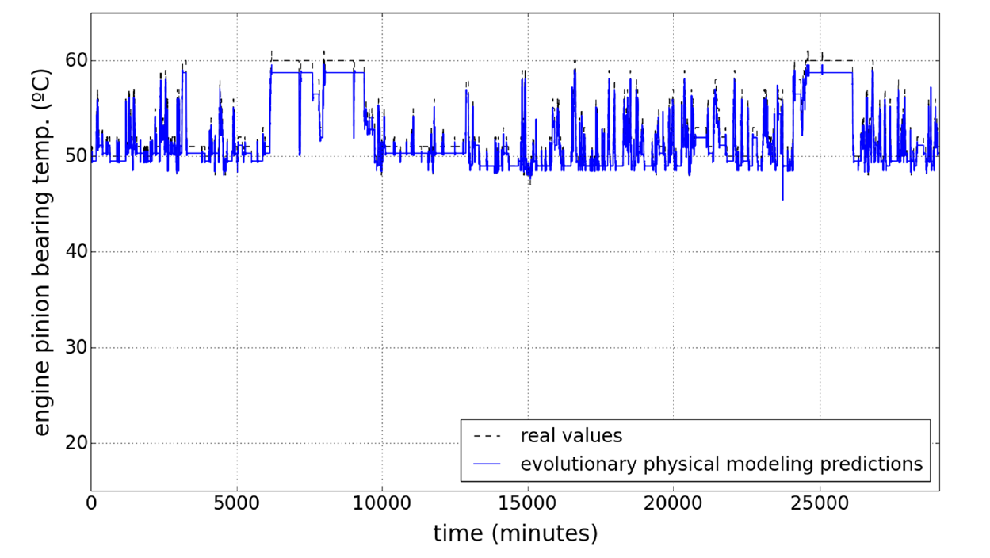
The prediction undertaken by the evolutionary model learned, together with sensor reading for the same input test data

Slide 12
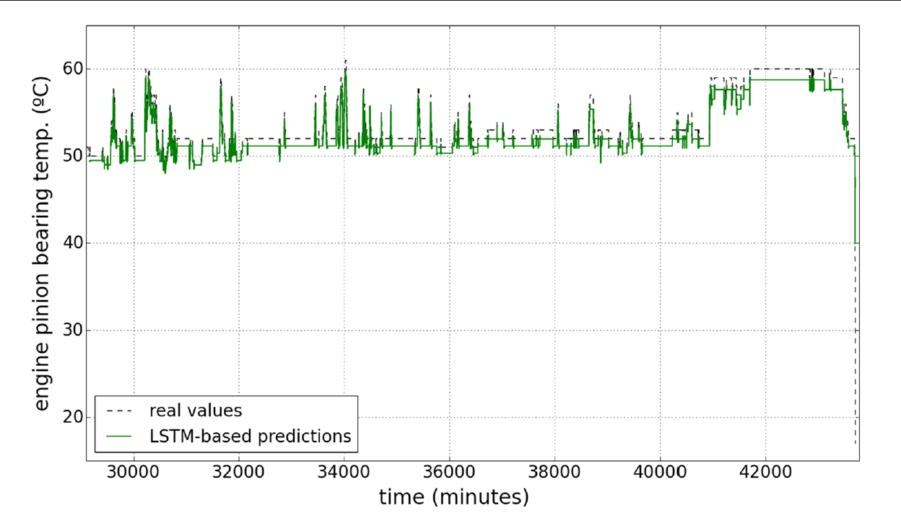
LSTM results on engine pinion bearing temperature validation data, real and predicted value over time.

Slide 13
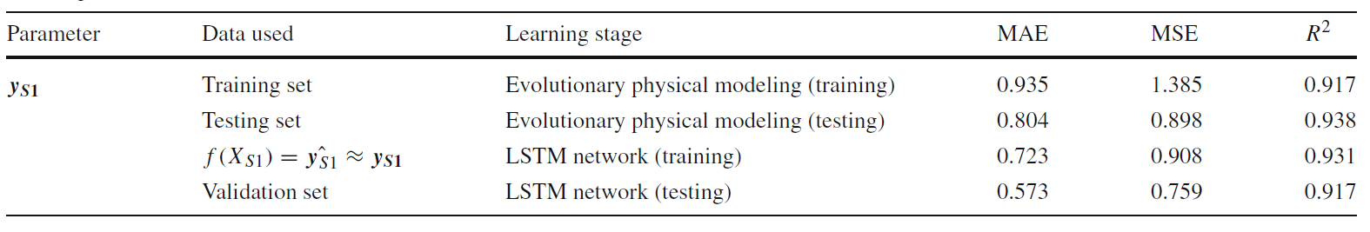
The above table summarises the result of deep evolutionary modeling for engine pinion bearing temperature training, testing and validation sets with diesel engine in stable operation.
Error rates decreased over time.
In comparison with the MLP network, it turned out that this latter performed slightly better than the former, obtaining MAE = 0.393, MSE = 0.578, R2 = 0.956 and MAE = 0.319, MSE = 0.526, R2 = 0.942 on training and test sets, respectively.

Slide 14
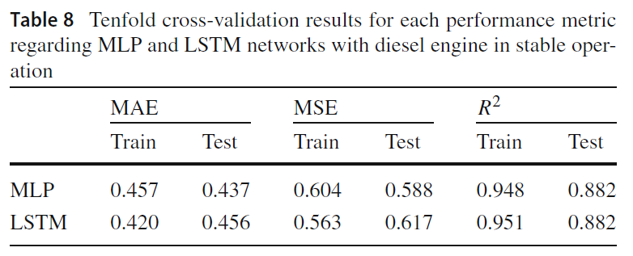
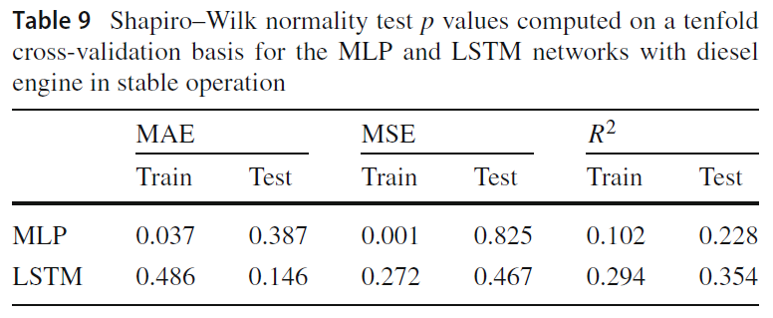
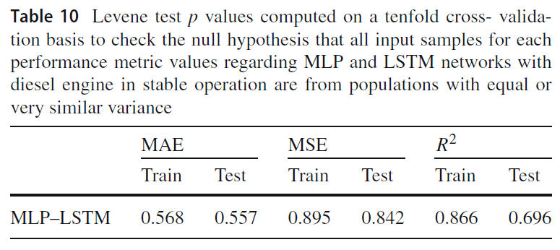
Results obtained when performing the tenfold cross-validation procedure demonstrate a more robust generalization in the case of the LSTM network,

Slide 15
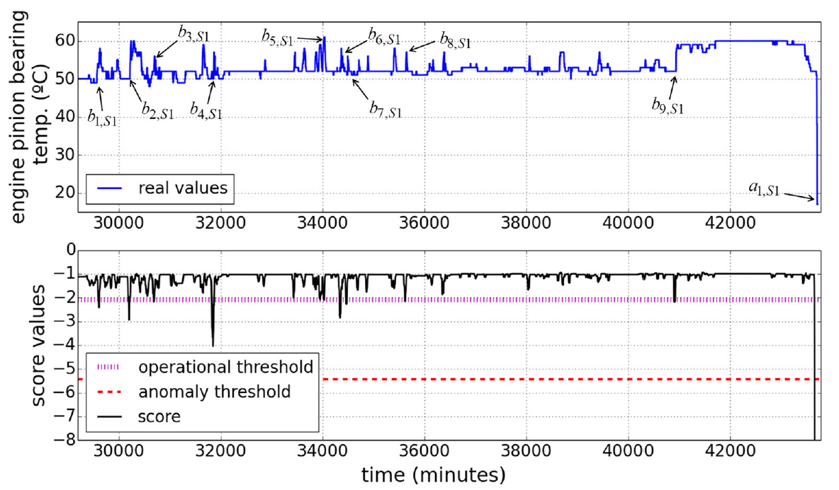
The real sensor readings (above) and the resulting operational and anomaly thresholds and score values on engine pinion bearing temperature (below) over the validation set

Slide 16
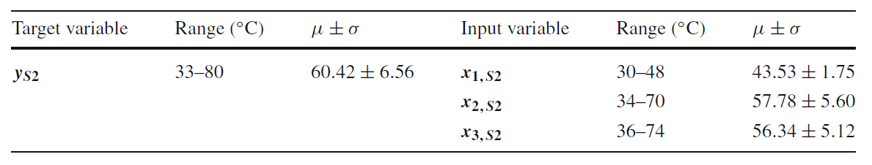
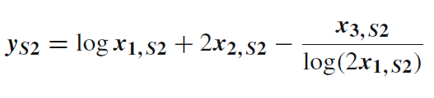
Scenario S2:
The details of the experimental parameters including range, mean (μ) and standard deviation (σ) used in this study with gas turbine in stable operation
Formula obtained regarding the gas turbine thrust bearing temperature in scenario S2
y_{S2} is the gas turbine thrust bearing temperature
x_{1,S2} is the main back thrust bearing temperature
x_{2,S2} is the engine pinion bearing temperature
x_{3,S2} is the 1st reduction pinion bearing temperature.

Slide 17
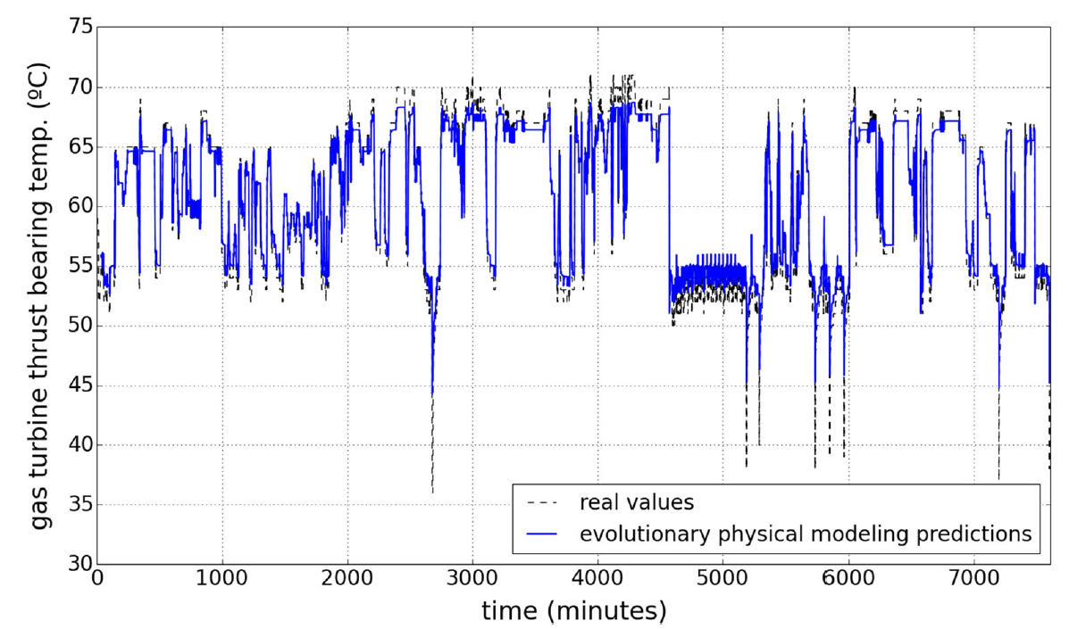
Evolutionary physical modeling results on gas turbine thrust bearing temperature test data, real and predicted values over time.

Slide 18
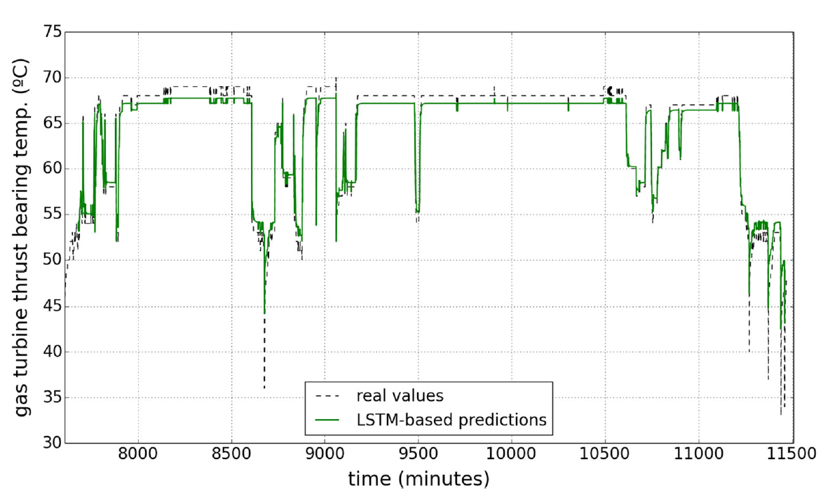
LSTM results on gas turbine thrust bearing temperature validation data, real and predicted values over time

Slide 19
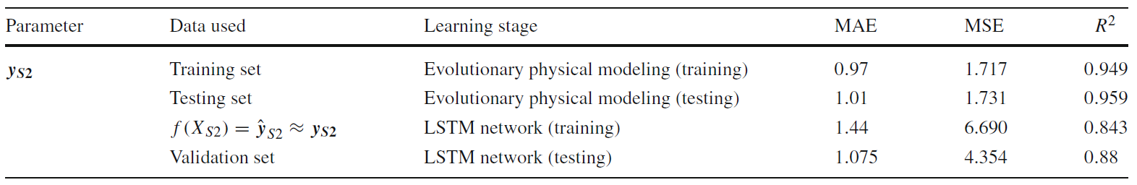
Results of the deep evolutionary modeling for gas turbine thrust bearing temperature training, testing and validation sets with gas turbine in stable operation
a slight decrease on performance can be appreciated when fitting the deep network to the evolutionary physical modeling values, this can be due to the more variable nature of the control parameter under study, the gas turbine thrust bearing temperature.
Decision trees-based modeling obtained good training results, largely similar to those obtained by the evolutionary model, namely MAE = 0.561, MSE = 0.61 and R2 = 0.986. It also generalized quite satisfactorily on the test set, giving MAE = 0.792, MSE = 0.992 and R2 = 0.974.

Slide 20
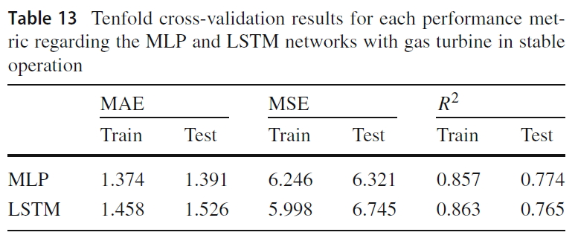
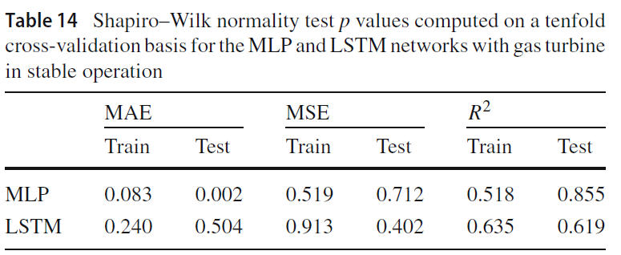
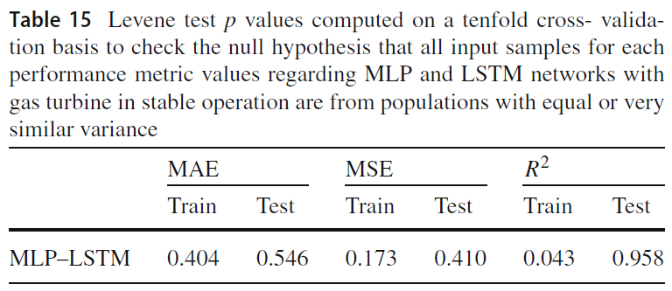
When comparing results given by the tenfold cross validation procedure, MLP and LSTM networks obtained very similar performance and generalization capacity. The R2 metric produced less accurate results in both methods.

Slide 21
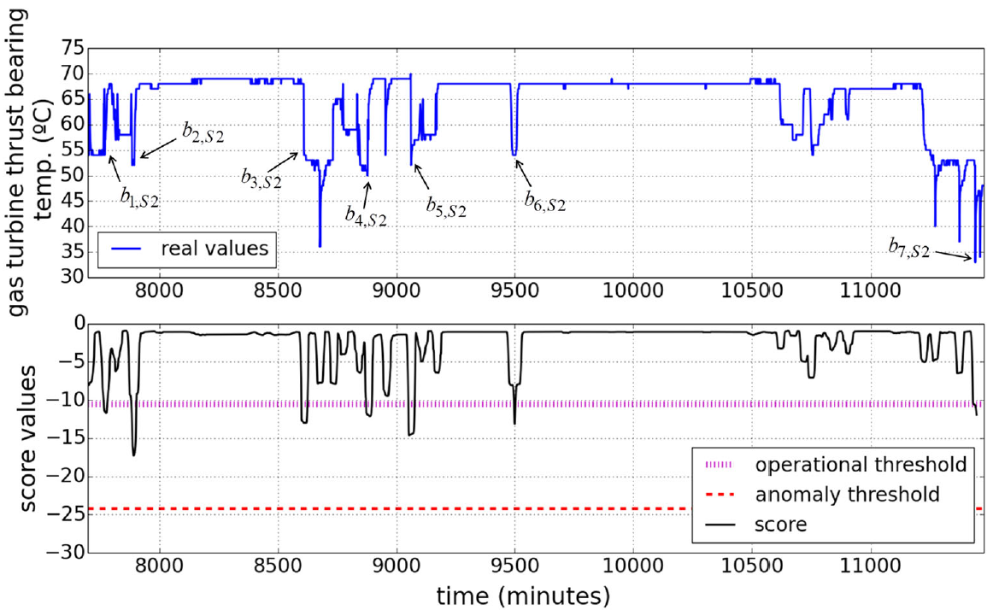
The real sensor readings (above) and the resulting operational and anomaly thresholds and score values on gas turbine thrust bearing temperature (below) over the validation set

Slide 22
THE END !!

Slide 23
TURBOFAN DATASET
Dataset Used : FD001
Previous result: Model Used : Linear Regression
RMSE: 39.58 ; R2_Score: 0.6697
Model Used: DecisionTreeRegressor(criterion = ‘mse’, max_depth = 7, random_state = 1)
RMSE : 30.4126 ; R2_Score : 0.8050

Slide 24
New Model is performed on data after splitting it in the ratio of 80:20 (train:test).
Linear Regression:
Train set:
RMSE : 39.72
R2_Score: 0.6698
Test set:
RMSE : 39.04
R2_Score: 0.6687
Decision Tree Regressor(criterion='mse', max_depth=10, random_state=1)
Train set:
RMSE : 19.7259
R2_Score : 0.9185
Test set:
RMSE : 24.6293
R2_Score : 0.8681

Slide 25
Random Forest Regressor(n_estimators = 10, criterion='mse', max_depth = None)
Train set:
RMSE : 7.4230
R2_Score : 0.9884
Test set:
RMSE : 17.0294
R2_Score : 0.9369
Random Forest Regressor(n_estimators = 100, criterion='mse', max_depth = None)
Test set:
RMSE : 15.7709
R2_Score : 0.9459

Slide 26
After applying PCA to the given dataset.
Number of components : 7
Decision Tree Regressor(criterion='friedman_mse', max_depth=6)
Train set:
RMSE : 36.0674
R2_Score : 0.7278
Test set:
RMSE : 36.9452
R2_Score : 0.7033

Slide 27
Decision Tree Regressor(criterion='friedman_mse', max_depth=9)
Train set:
RMSE : 29.6034
R2_Score : 0.8166
Test set:
RMSE : 34.8339
R2_Score : 0.7362
RandomForestRegressor(n_estimators = 10, criterion='mse', max_depth = None)
Train set:
RMSE : 12.9273
R2_Score : 0.9650
Test set:
RMSE : 30.8157
R2_Score : 0.7936

Slide 28
RandomForestRegressor(n_estimators = 100, criterion='mse', max_depth = None)
Train set:
RMSE : 10.9356
R2_Score : 0.9749
Test set:
RMSE : 28.6879
R2_Score : 0.8211
The rise in RMSE & fall of R2_Score can be attributed to the fact that while performing PCA, we lost certain dataset which were very useful while calculating the accuracy.

